Slide 1
(Yelp Database) Presentation
By
Ugochukwu Azubuine

Slide 2
Business Presentation

Slide 3
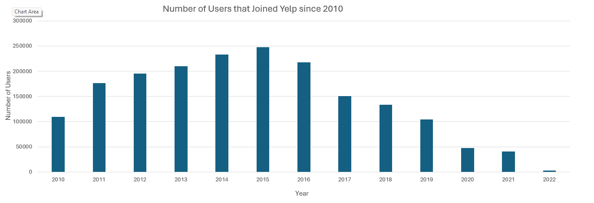
Annual User Growth on Yelp (2010 – 2022) How many users have joined Yelp each year since 2010?
The number of users that joined Yelp from 2010 to 2022 has a pyramid structure with 2015 being the top of the pyramid. There was a steady increase in the number of new users every year from 2010 to 2015 and the opposite from 2015 to 2022.

Slide 4
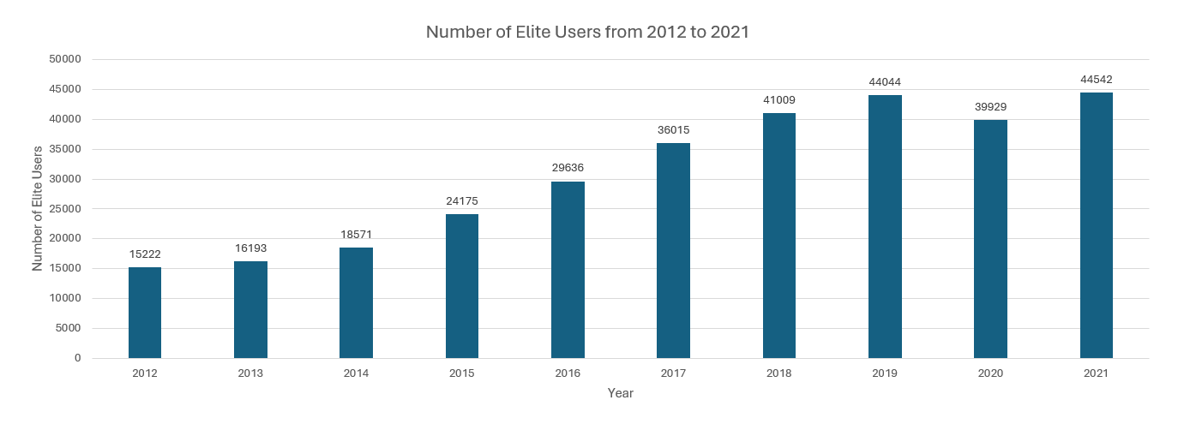
Elite User Trends Over a Decade (2012 – 2021) How many users were elite in the 10 years from 2012 through 2021? Does it look like the number of elite users is increasing, decreasing, or staying about the same?
It is increasing with an exception in 2020 where there was a decline, however, it went back on the increase in 2021.

Slide 5

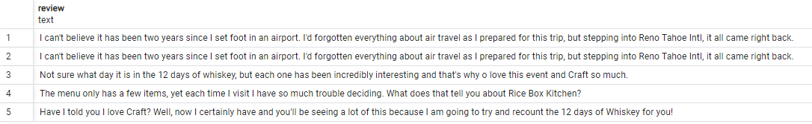
Top Yelp User with Most 5-Star Reviews Which of our users has the most 5-star reviews of all time? Give us the person’s name, when they joined Yelp, how many fans they have, how many funny, useful, and cool ratings they’ve gotten. Please also gives us 3-5 examples of recent 5-star reviews they have written.
Information of the user with the most 5-star reviews
Most Recent 5-star reviews by Micheal
Micheal is found to be the user with the most 5-star reviews. They joined in October of 2010 and have acquired a lot of fans with a huge 1,251 fans. Above are a few of Micheal’s recent reviews.

Slide 6
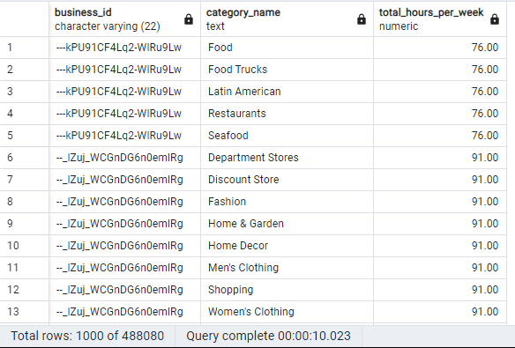
Business Hours vs. Review Performance Analysis We are wondering if there is any relationship between a business’s hours of operation and the reviews they receive. Can you give us a spreadsheet giving the following information for every business we have in our database: business id, business category, and total hours of operation per week (i.e., the total number of hours each business is open across the entire week)?
Above is a snippet of the spreadsheet with the required data. With this, we will be able to understand the relationship between a business’s hours of operation and the reviews received.

Slide 7
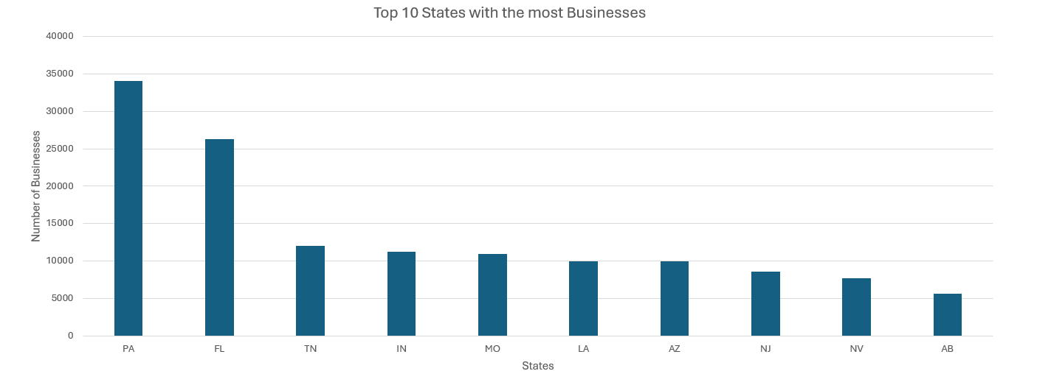
Leading States by Business Presence Which US states have the most businesses in our database? Give us the top 10 states.
Pennsylvania leads in having the most businesses among the top 10 states.

Slide 8
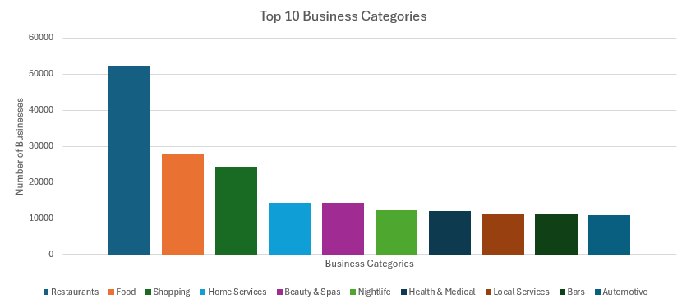
Key Insights: Top Business Categories What are our top ten business categories? In other words, which 10 categories have the most businesses assigned to them?
We can see most of the businesses fall into the Restaurants category.

Slide 9
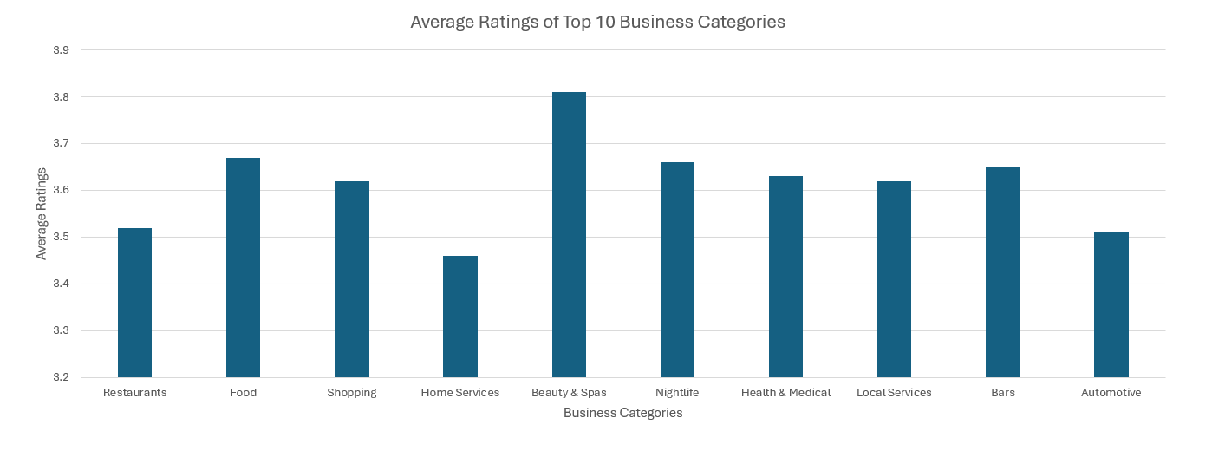
Rating Trends: Top Business Categories What is the average rating of the businesses in each of those top ten categories?
The average ratings of the top 10 business categories lie between the 3.2 and 3.9 mark.

Slide 10
Exploring Humor in Restaurant Reviews We’re wondering what makes users tag a Restaurant review as “funny”. Can you give us 5 examples of the funniest Restaurant reviews and 5 examples of the least funny? We’d also like you to look at a larger set of funny and unfunny reviews and tell us if you see any words or phrases that are commonly found in the funniest reviews. (We know the last part is qualitative but tell us anything you see that may be useful.)
Top five funniest Restaurant reviews
1. "Went there for a birthday dinner and had reservations for 9 people (and 3 additional people showed up) after a grueling 2 hr wait and several drinks we finally got seated only to be told that because we had 3 extra people that we would have to split our party up and they would have to wait for a table!... Regarding to Broadway Oyster owner... Hopefully, something like this is will never be a concern."
2. "Went to dinner here with the wife and the in-laws. Extremely solid all around. Great service, classy atmosphere, and extremely delicious food…Dessert was all winners too. It's pricey, but it should be, because it's worth it."
3. "Went to Brick's last night and it was amazing! A true Reno gem that I highly recommend - an absolute must. The staff is friendly and efficient, but it's truly the food that takes center stage…Here's the lineup…Super rich and decadent desert - I consider myself a chocolate lover, but we had to tap out less than halfway through the slice. Don't get me wrong, it was delicious, but perhaps a bit too rich or our blood."
4. "I don't know why I used to think Bricks was a French restaurant. Maybe it was at one point but it is now contemporary American with seafood…They have a seperate bar area where you can eat solo which I like and a very attentive, professional bartender."
5. "Bricks is easily the nicest restaurant in Reno! Such a beautiful space and classy food. They gave our group the 5 star treatment!... My entree was the Fettuccine Pescatore with huge chunks of lobster plus scallops and shrimp. Definitely a memorable meal with good friends in the Biggest Little City in the World!"
Some words that I found that were in the funniest reviews were:
‘birthday’, ‘dinner’, ‘nice atmosphere’, ‘excellent’, and ‘cuisine’
Five least funny Restaurant reviews
1. "The food was so much better than I expected. The steak cooked to perfection and the salad and sides were spot on. The best part, though, was our server Michael King. What a pro! If you want to see the consummate server/waiter in action, ask for him. I'm in the business of hospitality and this guy gets it. Period. Great evening, fantastic food and a wonderful experience. I highly recommend it!"
2. "Cute interior and owner (?) gave us tour of upcoming patio/rooftop area which will be great on beautiful days like today. Cheese curds were very good and very filling. Really like that sandwiches come w salad, esp after eating too many curds! Had the onion, gruyere, tomato sandwich. Wasn't too much cheese which I liked. Needed something else...pepper jelly maybe. Would like to see more menu options added such as salads w fun cheeses. Lots of beer and wine as well as limited cocktails. Next time I will try one of the draft wines."
3. "Wow! Yummy, different, delicious. Our favorite is the lamb curry and korma. With 10 different kinds of naan!!! Don't let the outside deter you (because we almost changed our minds)...go in and try something new! You'll be glad you did!"
4. "Amazingly amazing wings and homemade bleu cheese. Had the ribeye: tender, perfectly prepared, delicious. Nice selection of craft beers. Would DEFINITELY recommend checking out this hidden gem."
5. "Family diner. Had the buffet. Eclectic assortment: a large chicken leg, fried jalapeño, tamale, two rolled grape leaves, fresh melon. All good. Lots of Mexican choices there. Also has a menu with breakfast served all day long. Friendly, attentive staff. Good place for a casual relaxed meal with no expectations. Next to the Clarion Hotel."

Slide 11

Analyzing Tip Length and Compliments We think the compliments that tips receive are mostly based on how long the tip is. Can you compare the average length of the tip text for the 100 most-complimented tips with the average length of the 100 least-complimented tips and tell us if that seems to be true? (Hint: you will need to use computed properties to answer this question).
Yes, it is true, as the top 100 most complimented tips have a significantly higher average length of tip comments than the average length of the 100 least complimented tips

Slide 12
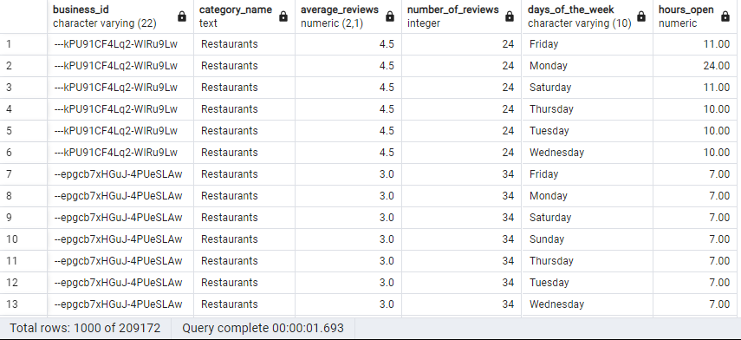
Factors Influencing Restaurant Reviews We are trying to determine whether restaurant reviews are driven mostly by price range, how many hours the restaurant is open, or the days they are open. Please give us a spreadsheet with the data we need to answer that question.
Above is a snippet of the spreadsheet with the required data. I believe we can find out if the reviews of restaurants are driven by the number of hours a business is open and/or the days the restaurants are open using the spreadsheet above

Slide 13
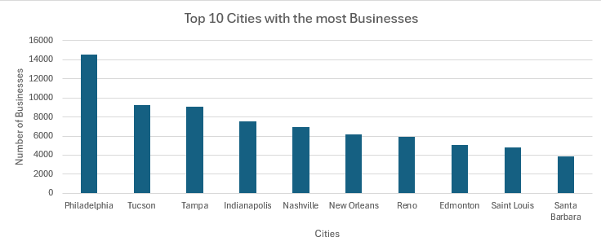
Leading Cities by Business Presence on Yelp What are the top 10 cities with the highest number of businesses registered on Yelp?
Philadelphia has the most businesses in the yelp database

Slide 14

Highest Rated Business Category Analysis Which business category has the highest average rating across all businesses?
The businesses in the Art Consultants categories have the highest average rating with an impressive rating of 5.0

Slide 15
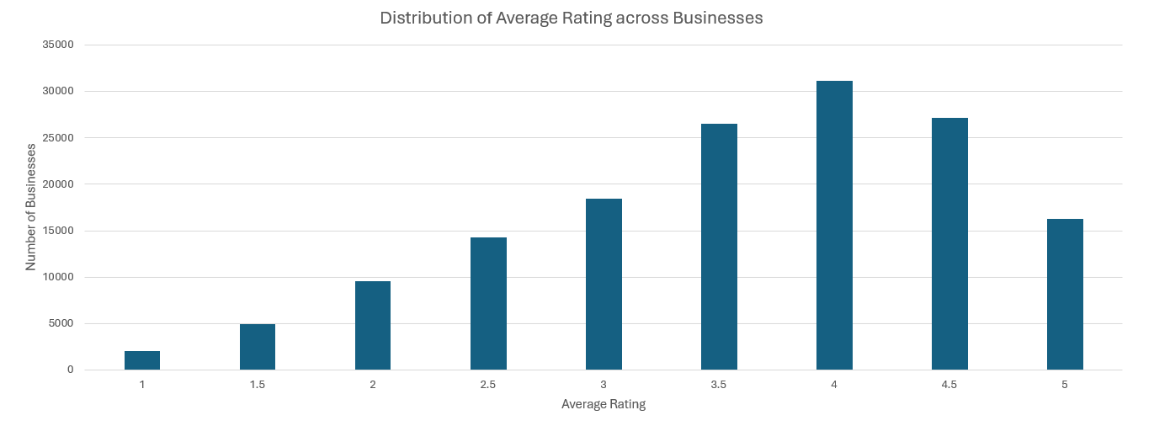
Business Rating Distribution Overview What is the distribution of business ratings? (e.g., How many businesses have a rating of 5, 4, 3, etc.)
We can see the majority of businesses have an average rating of 4 and very few have an average rating of 1

Slide 16
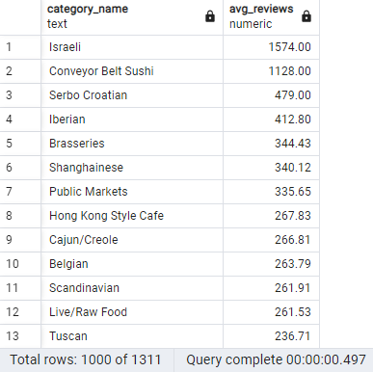
Variation in Business Review Counts by Category How does the average number of business reviews vary across different business categories?
With this table, we see the categories with the highest reviews by taking the average of all reviews for each category

Slide 17
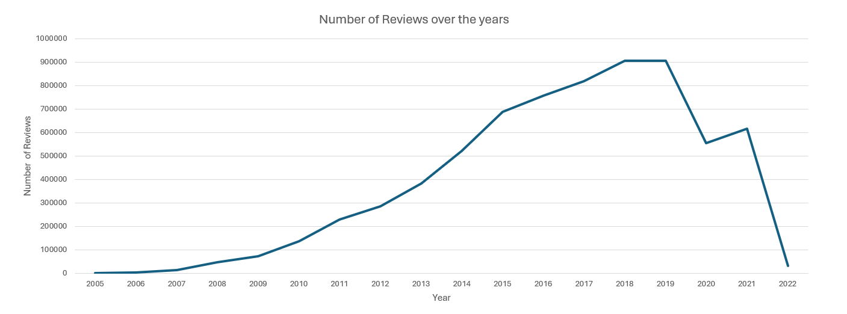
Evolution of Business Reviews Over Time How has the number of business reviews changed over the years?
The number of reviews has been on the increase from 2005 till 2019 where there was a plummet and the decline continued till 2022

Slide 18
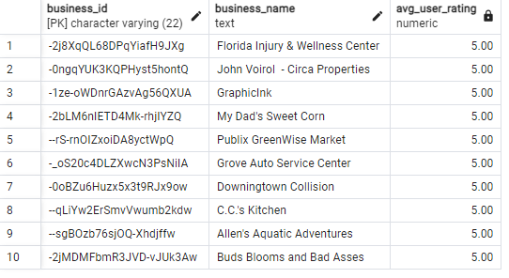
Top Rated Businesses: A Closer Look What are the top 10 businesses with the highest average ratings?
Above we have the top 10 businesses with the highest average ratings

